Slide 1


MEASURING QUIC PERFORMANCE
An analysis of Security and Connection Establishment in QUIC with comparison to TCP
Lara D'Agata
2526633d
Notes:
My name is Lara and my dissertation is about Measuring QUIC Performance by analysing the security and connection establishment of QUIC connections and comparing it to TCP.

Slide 2
Motivation
Quick UDP Internet Connections (QUIC)
Recently Developed and Deployed.
Libraries and Implementations: New and Poorly Documented.
Increasing Support in Recent Years.
Transmission Control Protocol (TCP)
Reliable, Universally Supported, Extensively Documented.
Compare QUIC with TCP in terms of Security Parameters and Overall Performance
Notes:
QUIC is an Internet transport layer protocol which has been in development since 2016 and has recently been deployed and finalised by the IETF in 2021. Although it has been received extremely well, and has gained increasing support over the past few years, its surrounding libraries and implementations are new and poorly documented.
TCP has been the most widespread transport protocol across the Internet over the last 40 years: it is reliable, largely supported throughout the Internet, and is extremely well-documented.
The introduction of QUIC represents a promising improvement to the transport protocols that are currently in use, both in terms of speed and security of its connections. The creation of QUIC opens up the possibilities of development throughout the entire field of networking, and lays the groundwork for the evolution of newer, more efficient transport protocols in the future.
However, despite the encouraging prospect of faster, more secure connections over the Internet, QUIC does not yet benefit from the reliability of older protocols like TCP. According to the existing research which has been conducted in the field, it is not yet known whether QUIC actually established secure parameters correctly, or whether it is faster than TCP in every scenario.
With this project, I aim to measure the current state of deployment and performance of QUIC, in the hopes of encouraging its development.

Slide 3
Research Aims
Observe whether QUIC really yields more benefits than costs to Internet Connections.
Address gaps in Existing Research:
Measure Performance of QUIC Actively.
Record any Security Vulnerabilities Encountered.
Compare QUIC to TCP.
Notes:
In order to achieve this, it is necessary to observe whether QUIC actually yields more benefits than costs when it comes to establishing secure connections over the Internet.
The main aims of this research study involve addressing the gaps in the existing research regarding QUIC performance that has been conducted in recent years.
Given QUIC’s recent deployment, not many studies have explored the actual performance of QUIC connections in the real-world. I addressed this problem by conducting active measurements over the Internet using QUIC as a transport protocol. The security configuration of real QUIC connections has also not been researched a lot, so I also recorded any security parameters or vulnerabilities encountered during the active measurements. Due to the lack of comparative studies investigating the difference between QUIC and TCP, I performed the measurements using TCP as well as QUIC in order to make a fair comparison in my analysis.

Slide 4
Experimental Design
Data Collection on Linux VM
2 Locations: Home Router & High-Speed Server.
Querying 1000 Most Popular URLs.
Using tcpdump to conduct a Packet Capture.
Data Analysis in Python
Extracting pcap data.
Parsing qlog records.
Notes:
In order to conduct these measurements, I designed an experiment which involves 2 main aspects: data collection, and data analysis.
In the data collection stage, I conducted the measurements by querying the 1000 most popular sites as of January of this year, using both QUIC and TCP. This was done by writing a packet-capture script in Bash and running it on a Linux VM. The measurements were taken from 2 disctinct locations: one was a home router, while the other was a high-speed server in the department of Computing Science of the university of glasgow. These two locations acted as the Client in a Client-Server connection with each URL. Packet sniffing tools such as tcpdump and curl were used **to record all packets exchanged on each connection, storing them in folders for easy access.
Once all the measurements had been conducted, the data obtained was analysed in Python. For the TCP connections, the packet-capture files generated by tcpdump were enough to analyse. However, due to the encrypted nature of QUIC packet headers, it was necessary to obtain qlog files for QUIC connections instead, which contain records of each packet sent or received in a given connection, and follow a very specific logging schema.
This data was parsed and turned into clear visualisations, including graphs and tables, which allowed a clear understanding of the results obtained.

Slide 5
Results
Connection Establishment
QUIC faster than TCP from Home Router.
TCP slightly faster than QUIC from High-Speed Server.
Round Trip Times
QUIC and TCP have similar RTT from Home Router.
QUIC much shorter RTT than TCP from High-Speed Server.
Notes:
So, in terms of connection establishment, QUIC proved to be faster than TCP from the home router. However, from the high-speed server at Location 2, TCP was actually the same if not slightly faster than QUIC at establishing connections.
Round Trip Times were also calculated for each connection, and it was found that QYUC and TCP have extremely similar RTTs from the home router, but for the high-speed server QUIC greatly outperforms TCP.

Slide 6
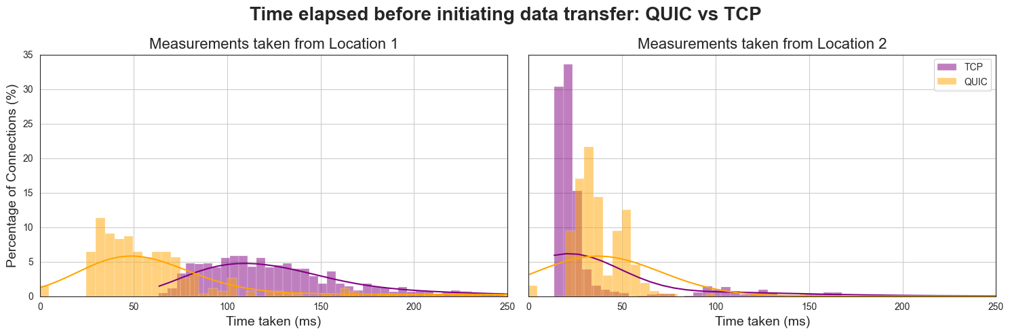
Notes:
This visualisation clearly depicts these results. The distributions shown in this graph display the time taken to establish a connection and initiating data transfer for QUIC in orange and for TCP in purple. The graph on the left shows the data collected from the measurements conducted at Location 1, which is the home router, while the graph on the right shows data from Location 2, which is the high-speed server. From the home router on the left, QUIC is more than twice as fast at establishing a connection and transferring data compared to TCP, whereas from the high-speed server on the right, QUIC is almost two times slower than TCP.

Slide 7
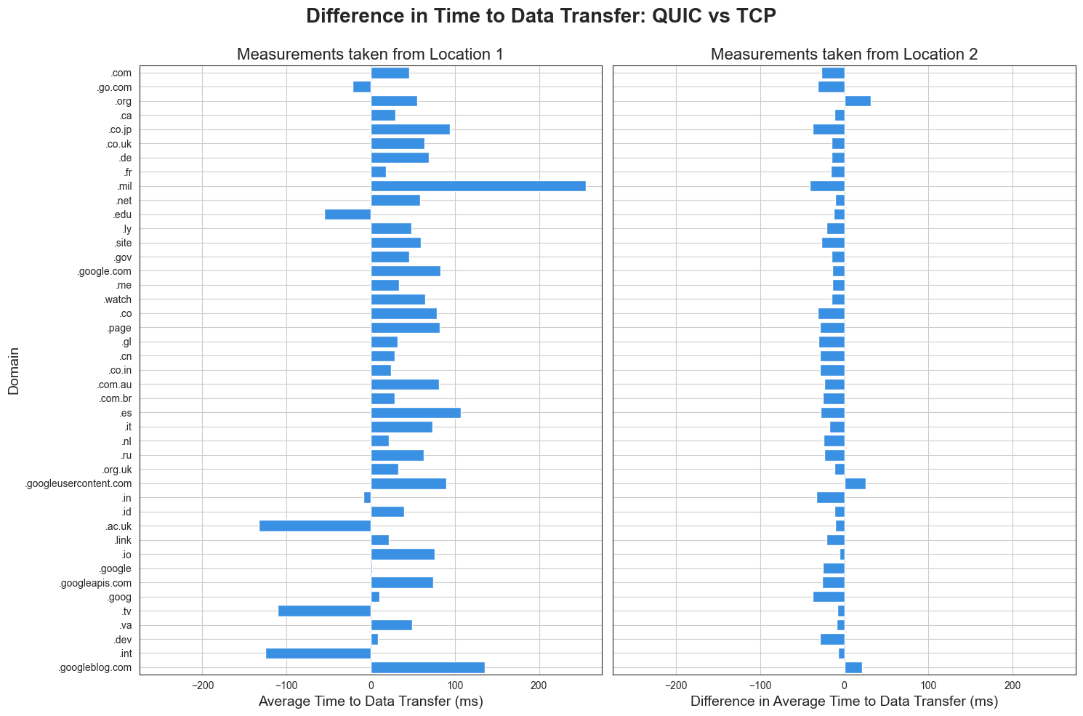
Notes:
Here is another visualisation for the same data, showing the difference in time taken before data transfer as an average for each domain. A positive value indicates that QUIC is faster, while a negative value indicates TCP is faster. It can also be seen here that for the home router QUIC is much faster than TCP, while for the high-speed server TCP actually proved to be slightly faster than QUIC.
These results indicate that, while QUIC outperforms TCP in a connection with regular latency and bandwidth, when operating at high speeds in a network configured to have low latency, TCP is still faster.

Slide 8
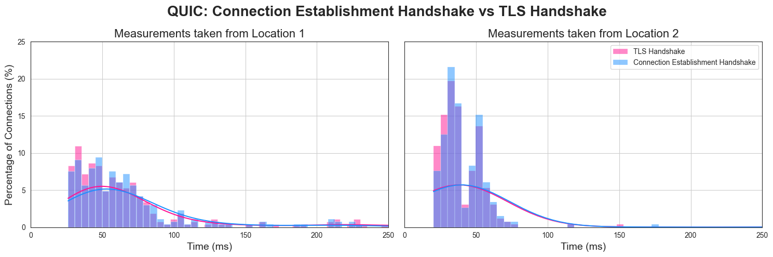
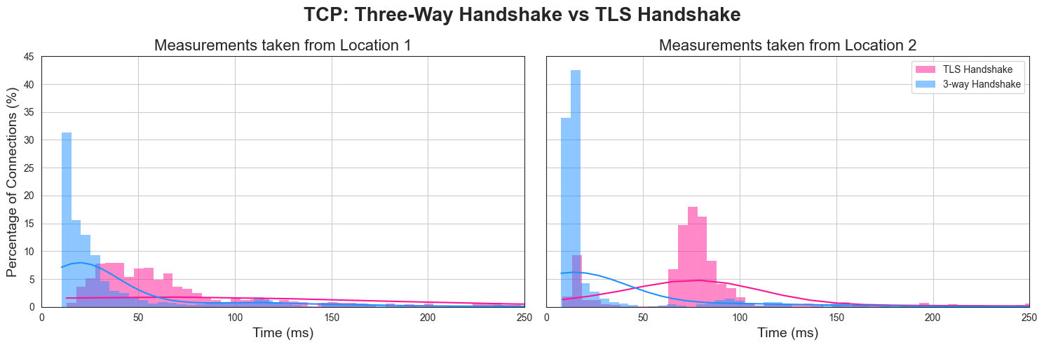
Notes:
The two graphs shown here display the differences in the transport and security handshakes that have to be performed in order to establish a connection. The blue distributions represent the connection establishment handshake, which initialises transport parameters for the connection, whereas the pink distributions show the transport layer security or TLS handshake. In the top graph, we can see that QUIC has a combined transport and security handshake, meaning that QUIC wastes no round trips when establishing a connection: we can clearly see the transport and security parameters being established at the same time. On the other hand, TCP connections require 2 separate handshakes and thus 2 round trips to establish a secure connection. As you can see from the bottom graph, the TLS handshakes are is clearly occurring after the transport ones. From these visualisations, we can tell that, although QUIC manages to establish all necessary transport and security parameters at the same time, the duration of its 1 round trip is not necessarily shorter than the two round trips necessary for TCP connections. Therefore, despite merging the two round trips into one, this is not always beneficial.

Slide 9
Results (part 2)
TLS Cipher Suites
QUIC and TCP established Cipher Suites for majority of connections.
TCP has more variation in Authentication and Key Exchange Algorithms compared to QUIC.
TLS Alerts
QUIC suffered up to 6x more TLS-related Connection Errors than TCP.
Notes:
In terms of security parameters, it was found that both QUJIC and TCP managed to establish tls vipher suites for the vast majority of the established connections. Although TCP demonstrated more variation in the authenmtivation and key exchange algorithms used, the combined transport and cryptographic handshake used in QUIC connections proved to be extremely efficient in establishing TLS ciphers, Indicating that QUIC is more than able to establish secure parameters in its connections. However, it was also found that TLS-related error messages were roughly six times more frequent in QUIC connections compared to TCP ones → this is definitely something to be investigated in future work.

Slide 10
Evaluation & Reflection
Lack of available Literature and Documentation.
Setting up the Virtual Machine.
SSH into Computing Science Department Server.
Compatible Versions of Dependencies.
Retrieving TLS information from pcap files.
Notes:
This project has proven to be an extremely insightful learning experience.
Examining QUIC performance in particular has been an inspiring experience, since this project is one of the first to take active measurements of QUIC connections over the Internet. The limited research available and lack of documentation of QUIC's performance and its related features has made this project both demanding and exciting, as it was challenging to conduct an experiment on such a newly developed technology in the field of networking.
The technical skills required to conduct this experiment were definitely a challenge to acquire, especially during the data collection stage. Generating and setting up the virtual machine to take active measurements was definitely one of the most challenging aspects of this project, as well as ssh’ing into the computing science department servers, but it was very rewarding once the measurements had been taken. Also retrieving information from pcap files, specifically TLS-related information, was a big challenge due to the incompatibility of certain dependencies in their newly updated versions, so dealing with these issues was definitely a key challenge throughout this project.
However, the most inspiring aspect of conducting this research was being able to observe how the Internet operates in the real world, and observing the performance of an extremely new transport protocol such as QUIC in real time has been extremely insightful.

Slide 11
Thank you
Lara D'Agata, 2526633d
https://github.com/laradagata/l4project/
Notes:
Thank you very much for listening to my presentation. For further information regarding my dissertation project, all of the source code can be found in the GitHib repository shown here, whgich is publiclt avaulable .

